Slide 1
Predicting Disasters Using Machine Learning and Deep Learning

Slide 2

TEAM MEMBERS
Aakarshit Srivastava (https://www.linkedin.com/in/aakarshit-srivastava-
b8252922a/)
Ayush Verma (https://www.linkedin.com/in/ayushverma135/)
Bhaskar Banerjee (https://www.linkedin.com/in/bhaskar-banerjee-
a55bb9228/)

Slide 3
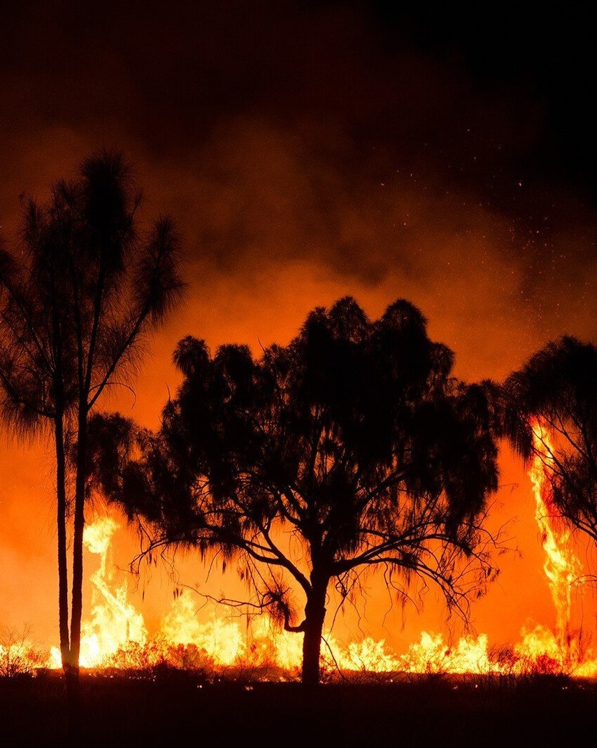
INTRODUCTION
Our project aims to develop a system that accurately predicts natural and technical disasters using historical and real-time data from the EM-DAT (Emergency Events Database). It will also suggest optimal response strategies based on these predictions to enhance disaster preparedness and management.

Slide 4

DATA SOURCE: EM-DAT
Overview of EM-DAT:
Contains data on the occurrence and eﬀects of over 22,000 mass disasters in the worlD Ffrom 1900 to the present day.
Types of disasters: natural (earthquakes, floods, storms) and technical (industrial accidents,
transport accidents).
Importance of EM-DAT Data:
Comprehensive and historical dataset.
Provides crucial insights into disaster trends and impacts.

Slide 5

DATA PREPROCESSING
Steps in Data Preprocessing:
Data Cleaning: Handling missing values and outliers.
Feature Selection: Identifying relevant features (e.g., disaster type, location, date, magnitude).
Data Transformation: Normalizing and encoding data for machine learning models

Slide 6

MACHINE LEARNING MODELS
Chosen Models: Random Forest Gradient Boosting
Support Vector Machines (SVM)
Why These Models:
Random Forest: Robust against overfitting and handles large datasets well.
Gradient Boosting: High accuracy and
performance in predicting outcomes. SVM: Eﬀective in high-dimensional spaces.

Slide 7
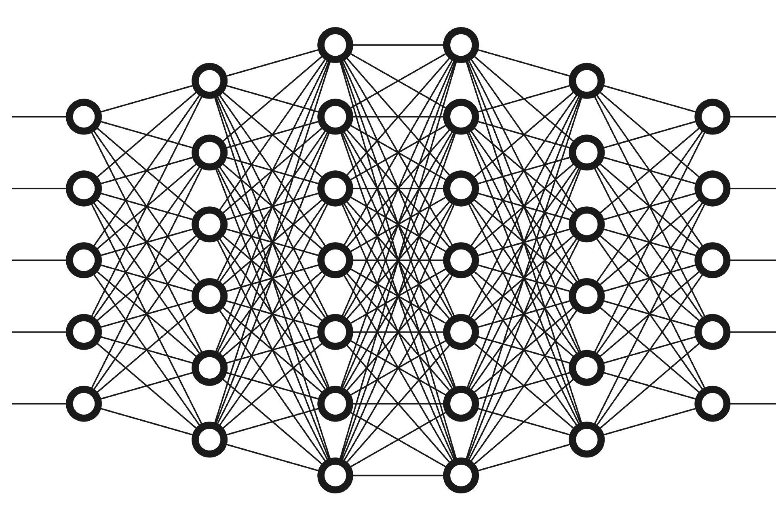
DEEP LEARNING MODELS
Chosen Models:
Recurrent Neural Networks (RNN) Long Short-Term Memory Networks (LSTM)
Convolutional Neural Networks (CNN) for spatiotemporal data
Why These Models:
RNN and LSTM: Good at capturing
temporal dependencies and trends in sequential data.
CNN: Eﬀective in extracting features from
spatiotemporal data such as satellite images.

Slide 8

MODEL TRAINING AND EVALUATION
Training Process:
Splitting the dataset into training and test sets.
Using cross-validation for model tuning.
Evaluating models based on accuracy, precision, recall, and F1-score.
Evaluation Metrics:
Accuracy: Overall correctness of the model.
Precision: Correct positive predictions over
total positive predictions.
Recall: Correct positive predictions over actual positives.
F1-Score: Harmonic mean of precision and
recall.

Slide 9
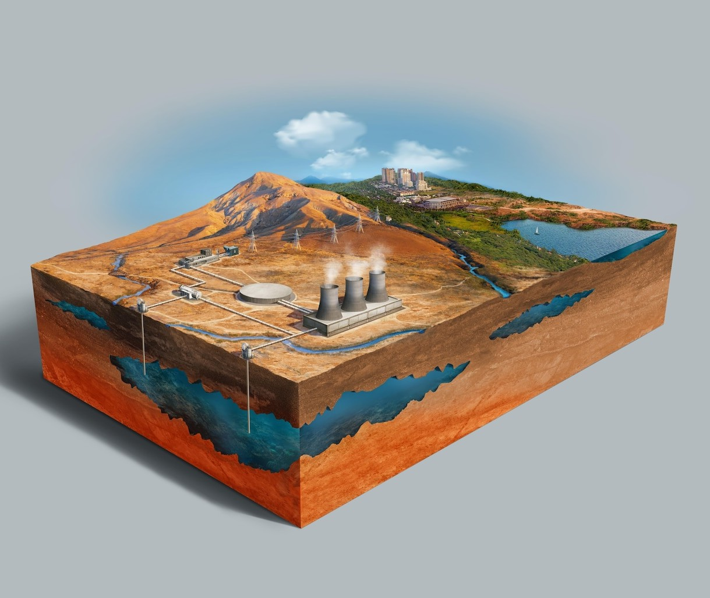
PREDICTION EXAMPLES
Natural Disasters:
Earthquake Prediction: Predicting location, magnitude, and potential impact.
Flood Prediction: Using weather patterns and
historical data to predict flooding events.
Technical Disasters:
Industrial Accidents: Predicting likelihood based on historical data and current
conditions.
Transport Accidents: Analyzing traﬃc patterns and historical accident data.

Slide 10

RESPONSE STRATEGY RECOMMENDATIONS
Natural Disasters:
Earthquakes: Evacuation plans, emergency supplies distribution, structural safety checks. Floods: Early warning systems, temporary shelters, flood defenses.
Technical Disasters:
Industrial Accidents: Emergency response teams, hazard containment, public
communication.
Transport Accidents: Rapid response units, traﬃc redirection, accident investigation.

Slide 11

SYSTEM ARCHITECTURE
Components:
Data Ingestion: Collecting real-time and historical data from EM-DAT.
Data Processing: Cleaning, transforming, and
preparing data for modeling.
Prediction Engine: Running ML/DL models to predict disasters.
Response Module: Generating and displaying response strategies based on predictions.
Diagram: Visual representation of the system architecture

Slide 12
CONCLUSION
Summary:
Effective disaster prediction requires robust data and advanced modeling techniques.
The combination of machine learning and deep learning enhances prediction accuracy.
Timely and accurate predictions enable better preparedness and response.
Future Work:
Integrating more real-time data sources.
Enhancing model accuracy with more advanced techniques. Expanding the system to include more types of disasters.

Slide 13
Thanks!
Do you have any query? https://github.com/Perfect- Cube

